Slide 1

PROJECT PRESENTATION
MET CS 521 by Anukool Shah

Slide 2

LOSSLESS DATA COMPRESSION
Lossless compression is a class of data compression algorithms that allows the original data to be perfectly reconstructed from the compressed data.
Lossless compressions algorithm used in this project:
Huffman Encoding/Decoding
Run Length
Huffman Encoding: The idea is to assign variable-length codes to input characters, lengths of the assigned codes are based on the frequencies of corresponding characters. The most frequent character gets the smallest code and the least frequent character gets the largest code.
Run Length: Run-length encoding (RLE) is a form of lossless data compression in which runs of data (sequences in which the same data value occurs in many consecutive data elements) are stored as a single data value and count, rather than as the original run.

Slide 3
IMPLEMENTATION DETAILS:
REQUIREMENT – PYTHON 3.10 OR ABOVE
THREE PYTHON FILES:
MENU.PY – Gives options to user to select from options 1 to 4. User selects an option to proceed with execution of an algorithm
HUFFMAN.PY – Contains a class and few private methods to calculate the occurrence of each symbol, create code for each symbol, create encoded and decoded version of the input. Also has a method to read a txt file and then encode and decode the contents.
RUNLENGTH.PY – Contains a class with init and other private methods to encode and decode an input, obtained from MENU.PY

Slide 4
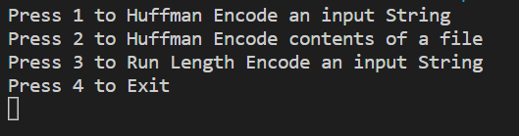
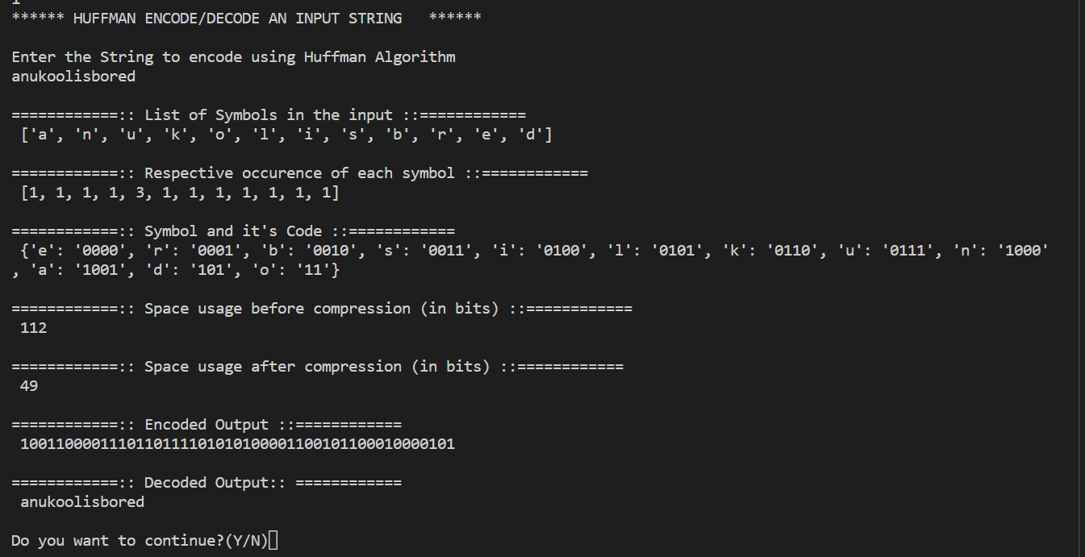
SCREENSHOTS

Slide 5
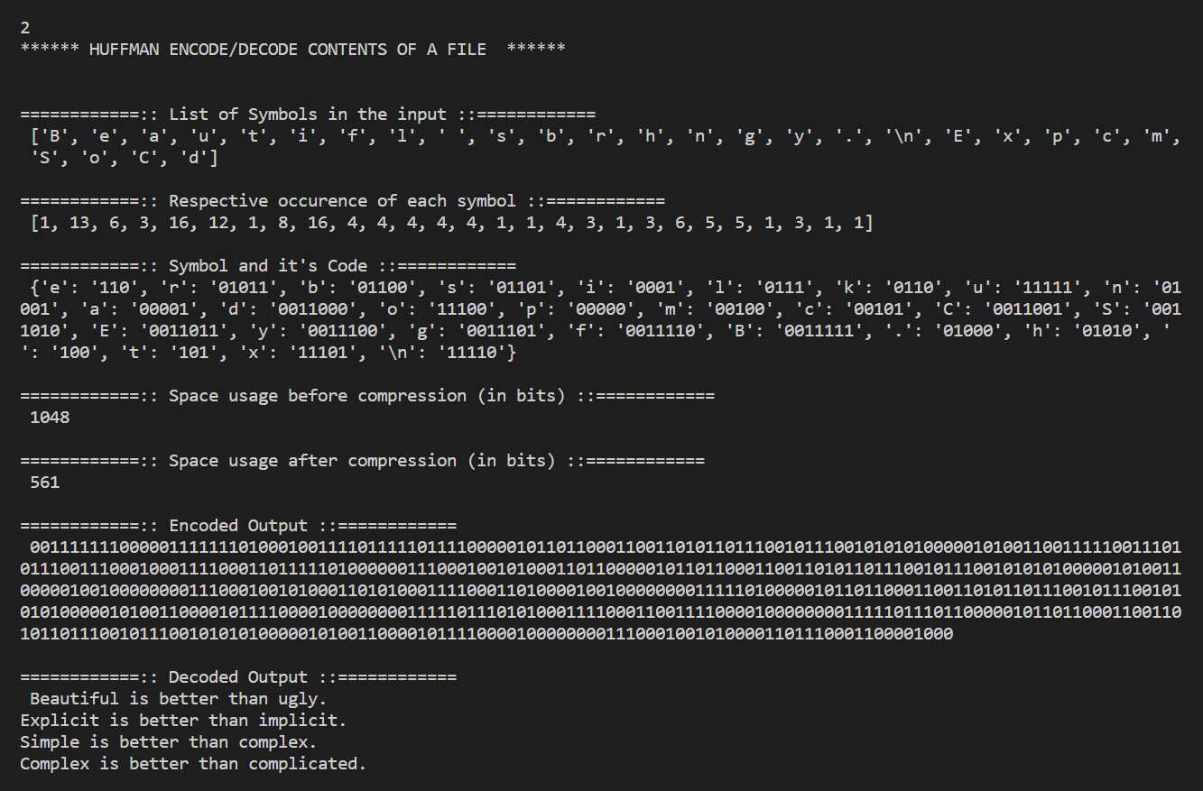

Slide 6
